Slide 1
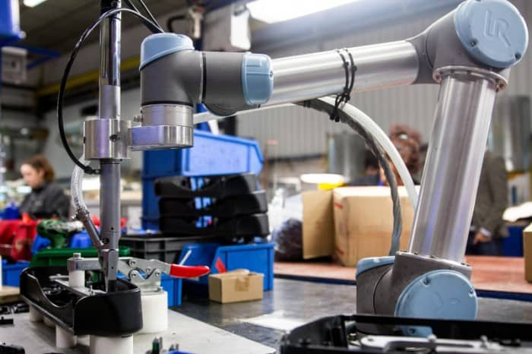

CSC485B Machine Learning for Robotics
SUNY Plattsburgh
Dr. Ned Lecky
Class 09- Regression Wrap-Up

Slide 2
Recall: Regression
X
F
Y
Recall: regression is just taking one or more input variables and using them to predict one or more output variables (SISO, MISO, MIMO)
MUCH mathematical theory BUT
The bulk of the theory assumes LINEAR equations
Much theory also assumes that the input variables are independent

Slide 3
A Potential Architecture
You did this as Homework 2
side1
side2
side1^2
side2^2
VERY SMALL
MLP
hypotenuse^2
area
y=sqrt(x)
hypotenuse^2
hypotenuse
side1
side2
hypotenuse
VERY SMALL MLP
perimeter

Slide 4
So Does This Have Any Practical Value
If it’s in this course, then HOPEFULLY!
So, an example?

Slide 5
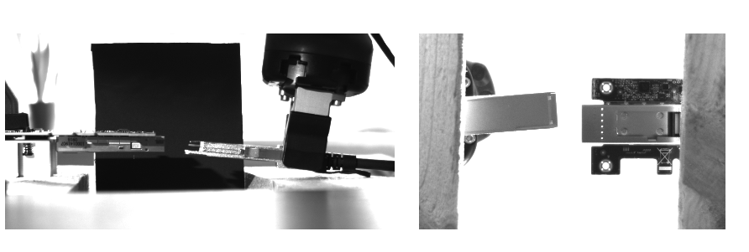
Back to Brighton Beach Lab
https://sites.google.com/lecky.com/brighton-beach-lab/home
The core problem: Plug Insertion
The socket moves relative to the world
The grasp of the plug in the gripper is unknown
Exact alignment to << 1mm is required and that is at the limit of the robot
Inspection just prior to insertion will be required to be successful

Slide 6
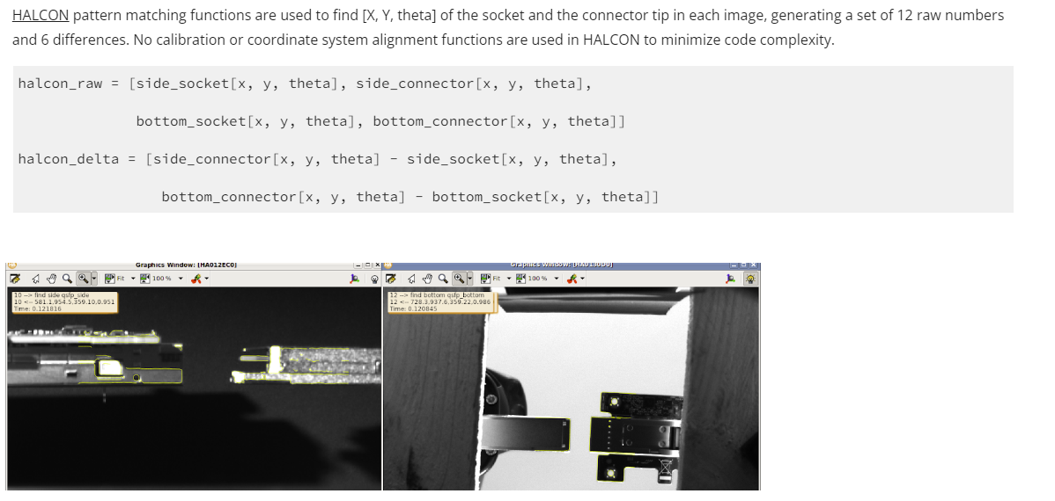
Extracting Alignment Features
Used HALCON from MVTec

Slide 7
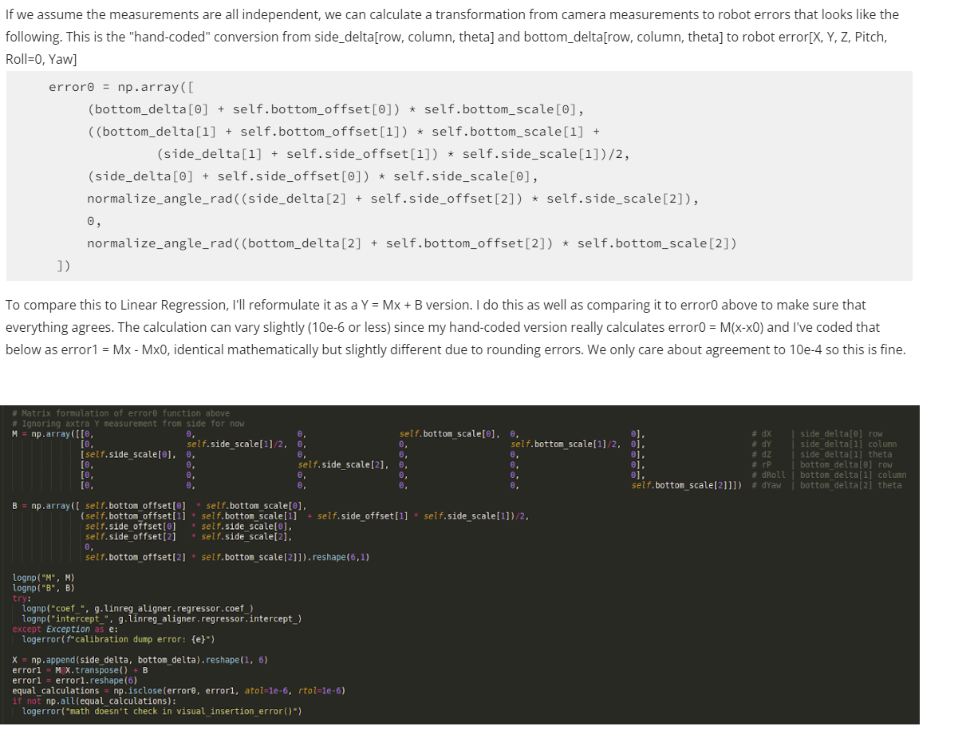
BBL Theoretical Calibration
Compare theoretical calibration (by hand) with what LinearRegression comes up with
https://sites.google.com/lecky.com/brighton-beach-lab/using-machine-learning/the-calibration-problem

Slide 8
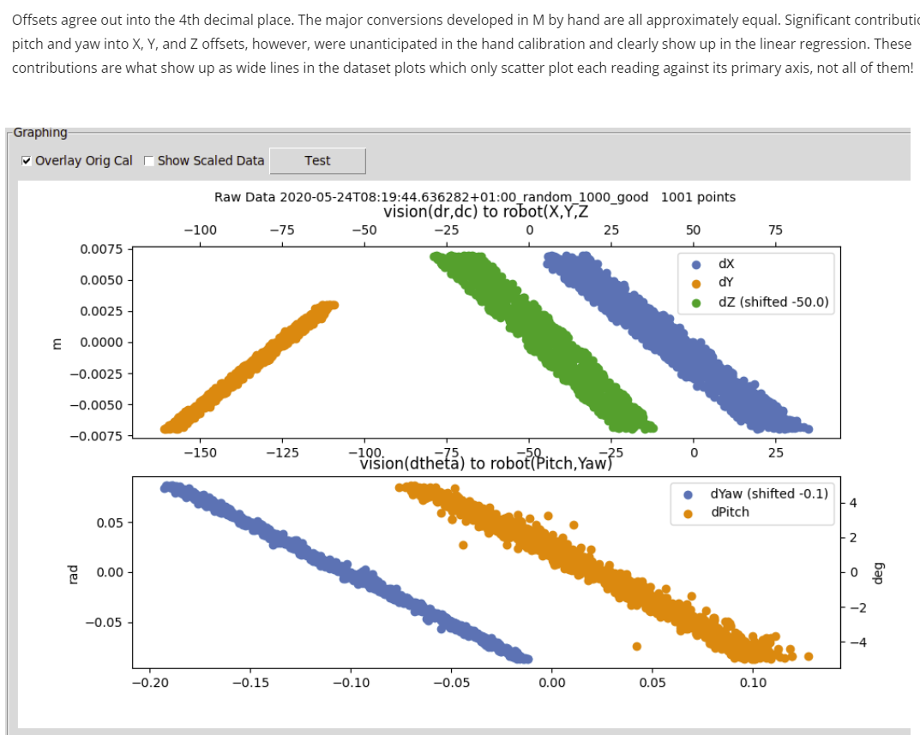
But it’s not accurate enough!
The relationships are close to linear but inputs are not independent!
An error of 1mm or 2 degrees makes insertion fail

Slide 9
Other Issues
We have variation we can’t really model
Slightly non-linear
Input variables not really independent
Camera positions not dependable or permanent
Lens-to-lens, position, robot-robot variations
How good are lenses?
https://www.edmundoptics.com/f/uc-series-fixed-focal-length-lenses/15027/
Check out specs
You even get variation based on light color!
Easy to automate collection of a training dataset

Slide 10
So… recommend auto calibration
Manually align connector to be “perfect”
Adjust, focus, lock-down all cameras
Run a robot program that offsets the connecter relative to perfect and acquires the measurement data
Now train something non-linear that doesn’t care much about input independence and you have a working calibration
AND: this process is automated and can be repeated at any time

Slide 11
Summary
You need to understand your data
You need to design a process…
Get data
Scale it appropriately
Augment inputs (maybe add x**2, or sin(x), or something you know will help)
Partition the problem into pieces if you can
Everyone likes end-to-end one-step ML because that looks cooler
Rarely meets customer requirements
(Log in to DMF???)

Slide 12
A look at my solution
Small walkthrough, not really a requirement!
And a tiny intro to Keras/TensorFlow
https://keras.io/

Slide 13
A Real Dataset
One I’m suffering with right now
A large team in Poland is working on making this reliable right now
Aurora Vision (formerly Adaptive Vision, now part of Zebra Technologies)
What makes things hard?
How else might we solve this problem (without ML/DL??)

Slide 14
CSC485: Where Next?
Classification with ScikitLearn (instead of Regression)
And we can mix in Keras to use other techniques as we go, BUT
If SciKit learn fails, you may do no better with “more” poorly thought-out ML! ☺

